Slide 1
2816 WWI
2022 Performance Presentation
2022/9/22

Slide 2
Disclaimer
This presentation is provided by Union Insurance Co., Ltd. (WWI). WWI makes no guarantees or warranties as to the accuracy, completeness or correctness of all the material contained in this presentation. After this presentation is released to the public, WWI undertakes no obligations to update any relevant data to reflect any changes hereafter.
This presentation may contain forward-looking statements. Statements that are not historical facts, including statements relating to the implementation of strategic initiatives, future business development and economic performance are forward-looking statements, and are subject to uncertainties, risks, assumptions and other factors that could cause such statements to differ materially from actual future events or results.
This presentation shall not be construed as an offer to buy or sell securities of the Company or as a guide to an offer.

Slide 3
Agenda
Company Profile
Business Overview
Business Performance
Financial Profile
Corporate Social Responsibility

Slide 4

Company Profile

Slide 5
Company Profile
WWI was established in 1963.
WWI (stock symbol: 2816) is the first listed non-life insurance company in 1992.
WWI acquired China Mariners’ Assurance Corp., the first successful M&A case in the non-life insurance industry in 2002.
In June 2007, WWI was acquired by Want Want Group, combined with the Group's unique business philosophy and culture and advantages, leading all colleagues to gather, Unity prosperous, open innovation, create great achievements.
WWI’s head office is located in Taipei with 15 branch offices, 13 service centers and 13 liaison offices set up throughout Taiwan, forming an island-wide network to develop business and provides customers with high-quality services.
WWI is committed to strengthening the corporate governance mechanism, actively fulfilling corporate social responsibilities, implementing the principle of fair hospitality, enhancing the company’s core capital and risk capacity, and creating shareholder value as the foundation for consolidating sustainable operations, making the company "most trusted insurance company" and will always work hard towards this vision.

Slide 6
Business Overview

Slide 7
Insurance Products
Personal Lines
Commercial Lines
Motor Insurance | Project Insurance | Residential Insurance | Travel Accident Insurance + Inconvenience Insurance | Accident and Health Insurance
Motorcycle insurance Automobile insurance | Cell Phone Insurance | Residential Fire & Earthquake Insurance Residential Comprehensive Insurance Household Comprehensive Insurance Residential Personal Property Insurance | Comprehensive Travel Insurance Specific Sporting Activity Comprehensive Travel Bubble Insurance | Personal Accident Insurance Group Accident Insurance Microinsurance Personal Health Insurance
Commercial Fire Insurance | Accident Insurance | Engineering Insurance | Marine Insurance
Commercial Fire Insurance Commercial Comprehensive Fire Insurance | Public Liability Insurance Employer's Liability Insurance Product Liability insurance Travel Agent Liability Insurance Other Insurance | Contractor's All Risks Insurance Erection All Risks Insurance Contractors Equipment Insurance Boiler Insurance Machinery Insurance Electronic Equipment Insurance | Marine Cargo Insurance Carrier's Liability Insurance Hull Insurance Fishing Vessel Insurance Aviation Insurance

Slide 8
Written Premiums Mix
Unit: NT$100m

Slide 9
Written Premiums Mix
Unit: NT$100m

Slide 10
Written Premiums
Unit: NT$100m

Slide 11
Retained Premiums
Unit: NT$100m

Slide 12
Premiums Growth Ratio

Slide 13
Market Share

Slide 14
Business Performance

Slide 15
Revenues
Unit: NT$100m

Slide 16
Net Income After Tax

Slide 17
Financial Profile

Slide 18
Balance Sheet
(In NT$100m unless otherwise noted)

Slide 19
Balance Sheet 2022Q2
Unit: NT$100m
ASSETS | 2022Q2 | % | LIABILITIES AND EQUITY | 2022Q2 | %
Cash and cash equivalents | 29.41 | 15.37% | Accounts payables | 14.31 | 7.48%
Receivables | 10.92 | 5.71% | Current tax liabilities | 0.03 | 0.02%
Current tax assets | 0.00 | 0.00% | Insurance liabilities | 120.88 | 63.16%
Financial assets at fair value through profit or loss | 11.30 | 5.90% | Provisions | 1.64 | 0.86%
 | 22.92 | 11.98% | Lease liabilities | 0.17 | 0.09%
Financial assets at fair value through other comprehensive income | 20.90 | 10.92% | Deferred tax liabilities | 0.64 | 0.33%
 | 24.72 | 12.91% | Other liabilities | 0.15 | 0.08%
Financial assets at amortized cost | 0.16 | 0.09% | Total LIABILITIES | 137.82 | 72.01%
Other financial assets, net | 8.54 | 4.46% | Ordinary share | 22.36 | 11.68%
Right of use assets | 40.90 | 21.37% | Legal reserve | 10.05 | 5.25%
Investment property | 12.60 | 6.58% | Special reserve | 24.60 | 12.85%
Reinsurance assets | 1.13 | 0.59% | Unappropriated retained earnings | (3.77) | -1.97%
Property and equipment | 7.90 | 4.13% | Revaluation gains (losses) on investments in equity instruments measured at fair value through other comprehensive income | 0.34 | 0.18%
Intangible assets | 29.41 | 15.37%
Other assets | 10.92 | 5.71% | TOTAL EQUITY | 53.57 | 27.99%
TOTAL ASSETS | 191.39 | 100.00% | TOTAL LIABILITIES AND EQUITY | 191.39 | 100.00%

Slide 20
Risk Based Capital Ratio(RBC%)

Slide 21
Sustainable Development Goals
(SDGs)

Slide 22
Corporate Social Responsibility(CSR)
●Diversified Board
●Comply with various laws and regulations
●Anti-Money laundering/ Countering the financing of terrorism
●Principle of Fair Hospitality
●Digital financial enhancement services
●Develop sustainable products
●Protect Customer Rights
●Offer Customer Complaint Mechanism
●Personal Information Protection
CSR
Committee
●Promote Micro-insurance
●Giving back to Township
●Caring for the society
●Form volunteers to participate
●Offer Employment Opportunities
●Value Industrial Relations
●Hence Salary Structure
●Enforce Labor Safety
●Enhance high quality training
●Gender equality
●Friendly work Environment
●Energy Saving
●Promote Digital Policies
●Evaluate Supplier Environment

Slide 23
Corporate Governance –
Financial Strength Rating
Standard & Poor‘s：
A-；Outlook：Stable
Taiwan Ratings：
twAA ；Outlook：Stable
A.M. Best Company：
A- (Excellent) ；Outlook：Stable
RBC％： 442.04%；Net Present Value： 27.99%

Slide 24
Actively Navigating climate change Shocks
In the Global Risks Report 2022, the world Economic Forum cited climate action failure as the most critical threat to the world in the next decade, followed by extreme weather, increasingly frequent catastrophe losses as a result of climate change have imposed challenges and opportunities.
Build a fine risk management culture and solid corporate governance through the establishment of risk management mechanisms and pertinent regulations. To enhance the implementation and effectiveness of risk management, internal control, and information security governance, WWI conducts at least one special audit on business operations that require further inspection of specific items based on actual business Conditions each year.

Slide 25
Green products ensure sustainable development
WWI vigorous support for the development of government policy , Offers property protection and liability coverage of Ubike in traffic accidents, makes us noteworthy guardian of the green industry in Taiwan.
Taiwan's agricultural products are often affected by low temperatures, heavy rain, and typhoons. WWI provides insurance for crops in response to government policies and the needs of farmers. Not only helps farmers overcome challenging environmental impacts, but steadily supports the sustainable development of our company.
WWI is insurance service provider for green energy in Taiwan with the part of market share in both solar photovoltaic energy and wind power sectors. Assists the renewable energy industry with the planning of feasible and sustainable insurance for the protection of social and national sustainable assets.

Slide 26
Insurance in the Digital Era
Creating a friendly environment for senior and physical impairment, WWI is here if you need extra care and support through the insurance process by visiting our website or to our offices.
WWI is using QR Codes to provide customers with detailed information such as policy terms and conditions via text, this service has been starting in March 2020 for Health / Personal Accident policy holders, and in October 2021 for motor insurance and home owners.
Staying connected with our clients and go public, in 2019 WWI has created agile business platforms, such as a Facebook page, a Line account and a You Tube channel. Where highlight our products and services, receiving and answering questions, a social networking site that makes it easier for WWI to connect with everyone.

Slide 27
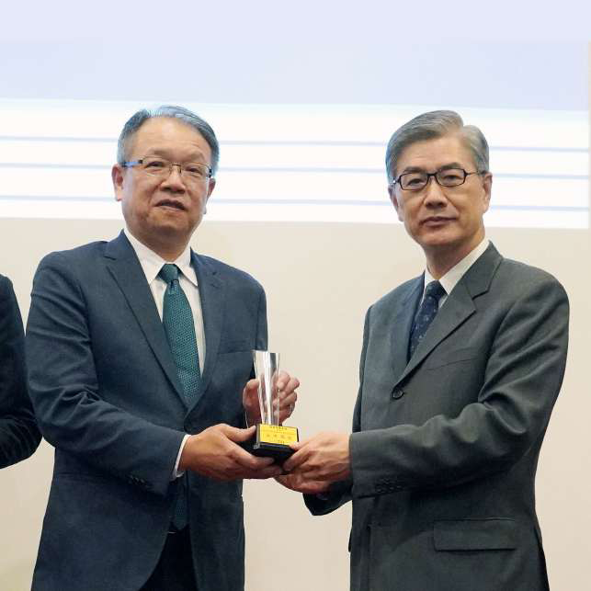
2021 Corporate Social Responsibility Participation-Micro Insurance
The most solid backing for the disadvantaged
WWI offers protection for low-income people against specific perils in exchange for regular premium payment. The Micro Insurance has been targeting 51 entities like Syin-Lu Social Welfare Foundation, and already provide coverage to 20000 people since 2014.

Slide 28
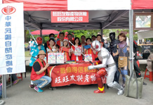
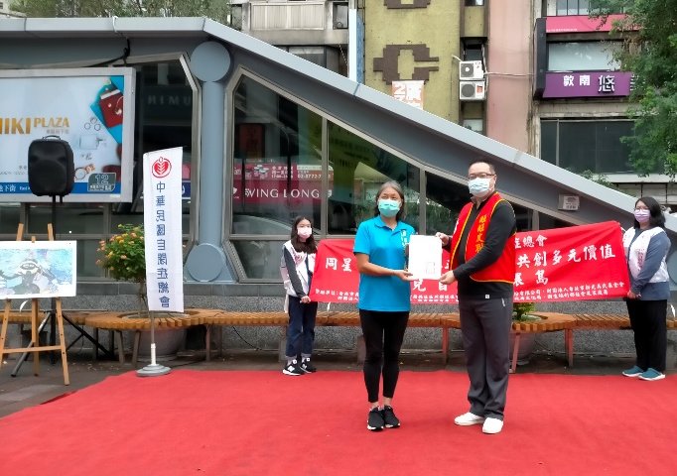
2021 love lasts uninterrupted-Welfare Activities
April 2 is "World Autism Awareness Day". The Autism Society of Taiwan held a "Let Love Bloom" at the end of March 2021. Through performances and outdoor gardening activities, children of autism were encouraged to go out for social interaction. By doing this, the public was able to understand more about people with autism while making connection with the international community to improve the flow of information on autism. At the same time, Union Insurance also recruited more volunteers to help children with autism. With concrete actions, our employees have dedicated their time on the weekend to help these children.
International Day of Persons with Disabilities falls on December 3 each year. In 2021, the Autism Society of Taiwan held the "Together We Can Transform Love - Equality Creates Multiple Values". A series of winning paintings were exhibited through a cycling campaign around Taiwan, hoping to promote concepts and information associated with those with autism. In doing so, we hope to respect differences and accept diversity so as to create a friendly society for autistic people and the public. The Union Insurance team also gave considerable support to sponsor relevant supplies and expenses needed to hold the exhibitions.
For 5 years in a row, Union Insurance has taken part in the "Yu-Xiang Cup National Wheelchair Badminton Tournament" held by the Changhua County Physical Disability Association. In doing this, not only is everyone encouraged to go out and integrate into society, this activity also encourages people with disabilities to embrace sports, finding their self-confidence in life.

Slide 29
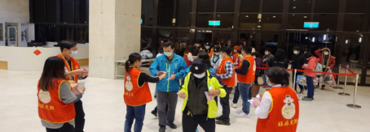
2021 love lasts uninterrupted-Welfare Activities
Since 2015, in order to thank the volunteers for their selfless dedication, Want Want China Media Group has held the "Let dedication be an Honor" charity concert across Taiwan. In addition to condolences to volunteers for their silent efforts in various units, the event also conveys the concept of "everyone for me, and me for everyone". Union insurance presented an LED three-purpose highlighter as a souvenir at the event, making the scene sparkle. Union Insurance expects that whether it is business owners, office workers, retired seniors, young students...as long as they have a heart to contribute to the society, everyone will join the ranks of volunteers with Want Want to spread love and care throughout Taiwan.

Slide 30
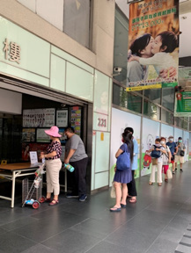
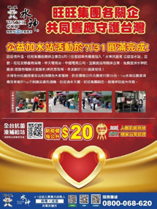
2021 love lasts uninterrupted-Disaster relief assistance
In May 2021, due to a surge in positive cases in Taiwan, the CDC declared the alert of the pandemic to level 3 and the public's demand for products for disease prevention, cleaning and disinfection soared. Due to this, Union Insurance took the lead to initiate the "Water God Anti-Bacterial Liquid - Public Welfare Water Station" campaign to provide free Water God Anti-Bacterial Liquid (slightly acidic electrolytic hypochlorite water) for the public. Each household was subject to receive 1 liter of Water God Anti-Bacterial Liquid. Union Insurance cares about people in Taiwan and strives to do what it can to help Taiwan fight against COVID-19.

Slide 31
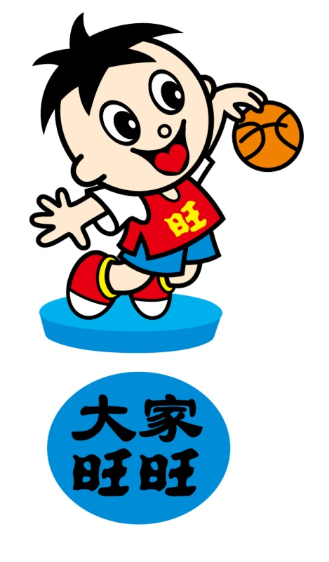
Thank you for your time!
Q & A

